Slide 1
Internet Enabled Garage Door Opener (Nodemcu ESP8266)
By: Anwar Ibrahim
Luis Garcia
Ileana Lopez
Notes:
Ileana

Slide 2
Outline
Problem Description
Requirement Specification
System Alternatives
System Design
Detailed Design
System Test Plan and Results
Economic Analysis
Project Management
Challenges
Future Work
Demo
Q&A
Notes:
Ileana

Slide 3

Problem Description
My team designed and implemented a garage door opener using a internet enabled node MCU with the target consumers being those who have a garage door.
The reason we chose this problem to tackle is because there are instances in which multiple people in a household that need to open/close their garage doors but do not have multiple door openers.
My team proposed to open the garage door from anywhere you're at using your mobile phone. Anyone will be able to open the garage door as long as they have the username and password.
Notes:
Ileana

Slide 4
Requirement Specification
The Deliverables
One working prototype of the internet enabled garage door opener using nodeMCU with a web application.
Video representation verifying the garage door opener working.
Schematic diagrams and circuit descriptions.
Notes:
Ileana

Slide 5
Requirements Specification Cont.
NodeMCU must be connected to a wifi network to be accessed over internet
Web Application has a login page that uses stored user information to access garage door opener
NodeMCU is powered using wall adapter
Dynamic status that changes based on whether the garage is open or closed
The garage opener must work over the internet meaning it works from anywhere
Notes:
Ileana

Slide 6
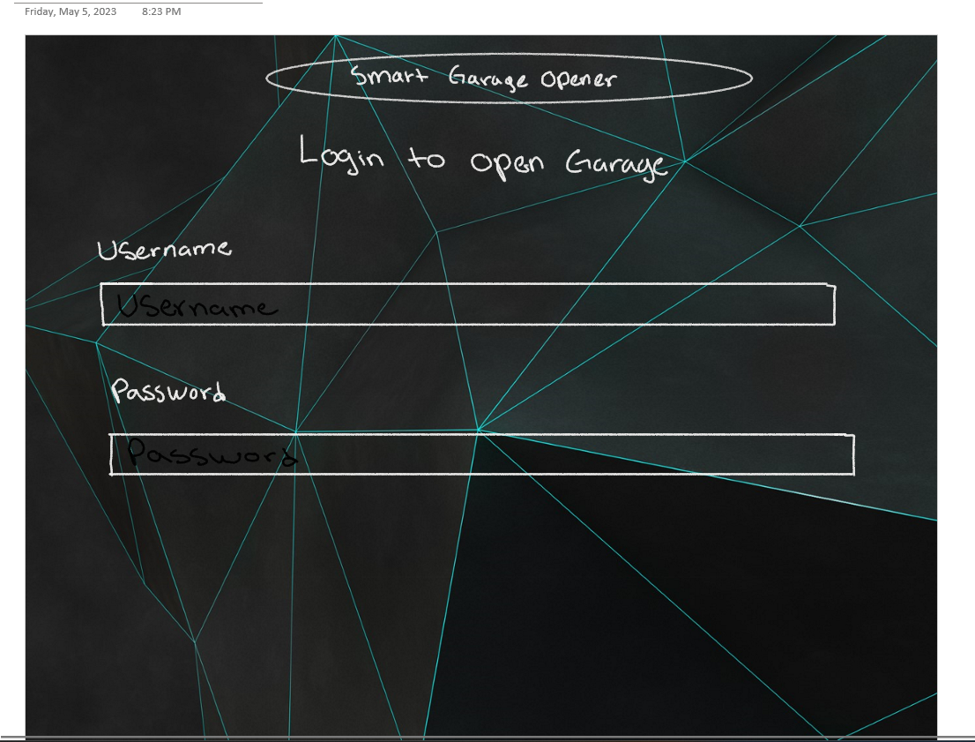
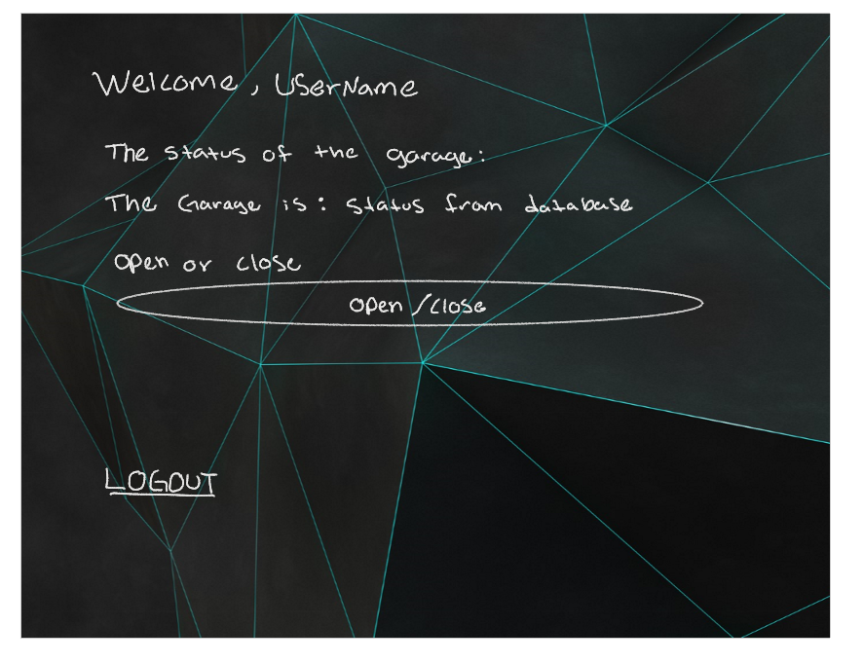
User Interface
Notes:
Luis:
Html and cascading sheets a bit of javascript
We are using php script which stands for hypertext preprocessor
Php is a server side scripting language which is used to develop dynamic applications.

Slide 7
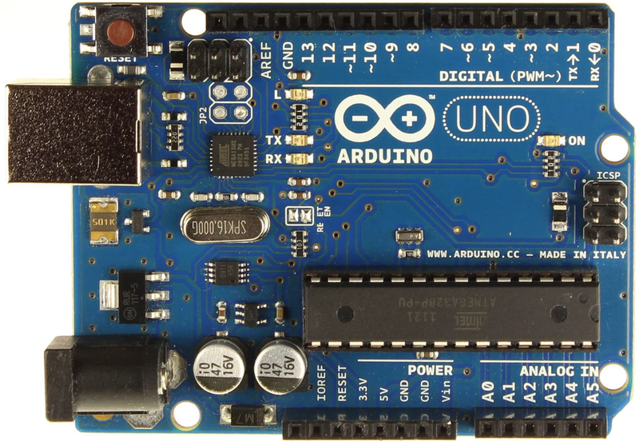
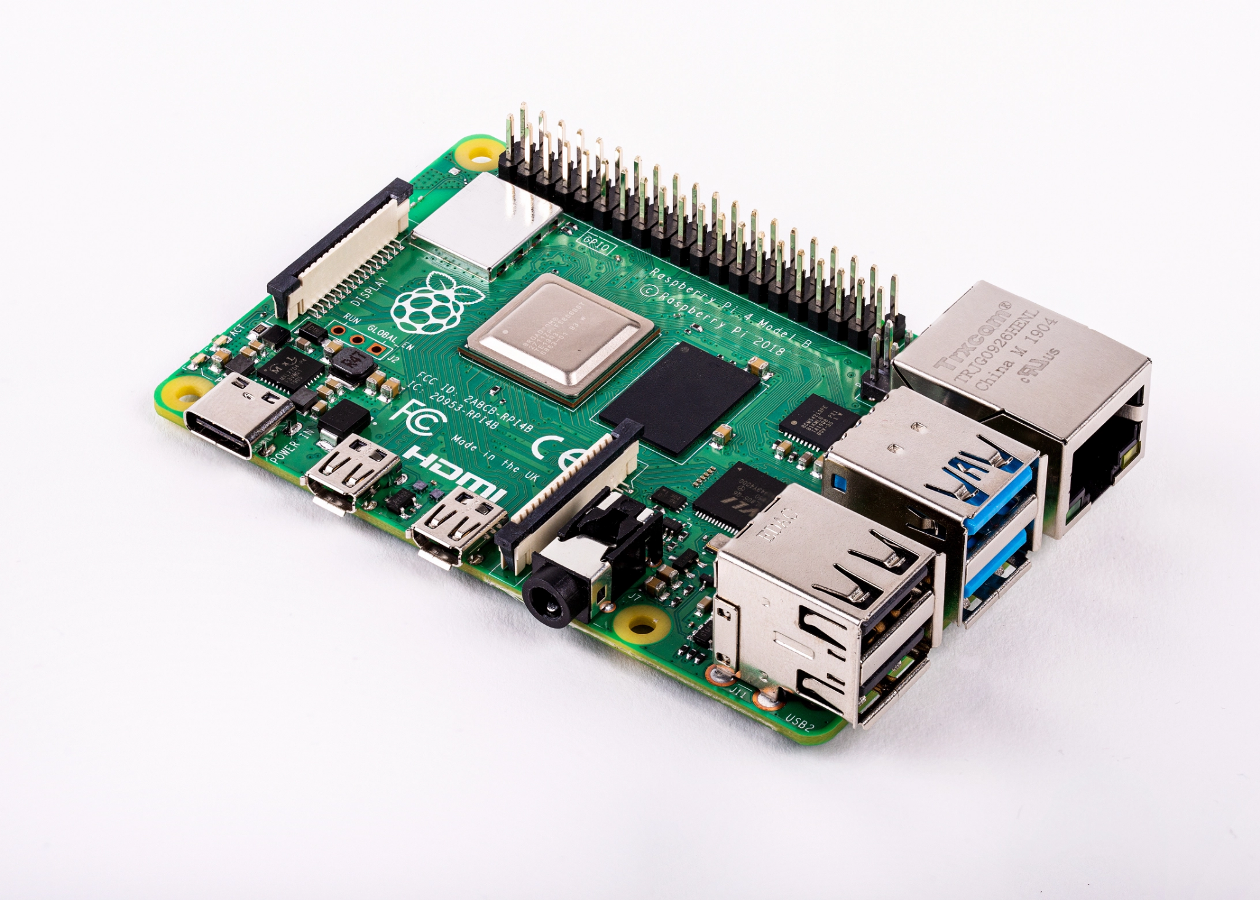
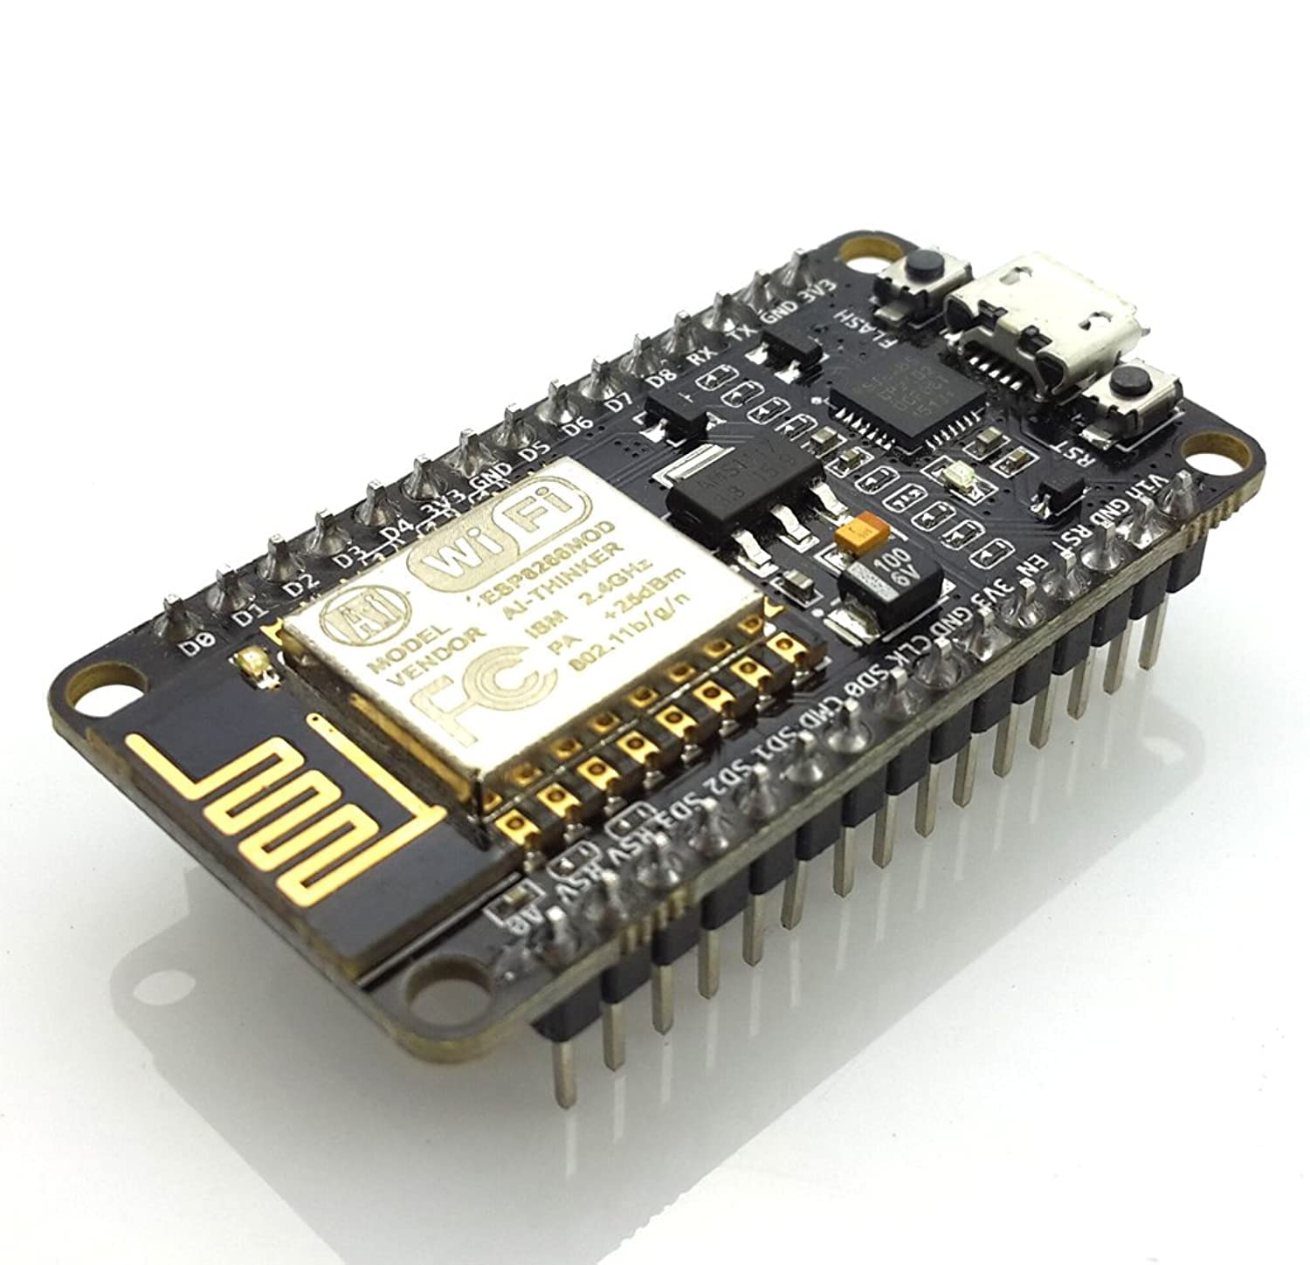
System Alternatives
Arduino With Wifi the chip was our second concept which came out to $18 for the board only. The arduino is compatible with the SQL database which is a requirement for us in the project. The price is reasonable compared to raspberry pi. A strength is my group has a strong or better foundation using this board than the other boards.
The raspberry pi is the most expensive among the three with prices ranging around 200 dollars. It is easier to use when working with databases and is basically a mini computer meaning it should be the most powerful, but the cost for this project does not justify choosing it over the alternatives.
The NodeMCU is the cheapest among the three with a cost of around 7 dollars. It is compatible with the Arduino IDE which we are familiar with. The processor speed varies from 80-160 MHZ. There are less resources in terms of documentation available compared to arduino, but it does the Arduino IDE meaning many of the libraries such as the one for the database should have an equivalent.
Notes:
Luis
Our system alternatives are arduino, the raspberry pi, and the nodeMCU. All these three microcontroller satisfied our needs so it really came down do the cost efficiency.

Slide 8
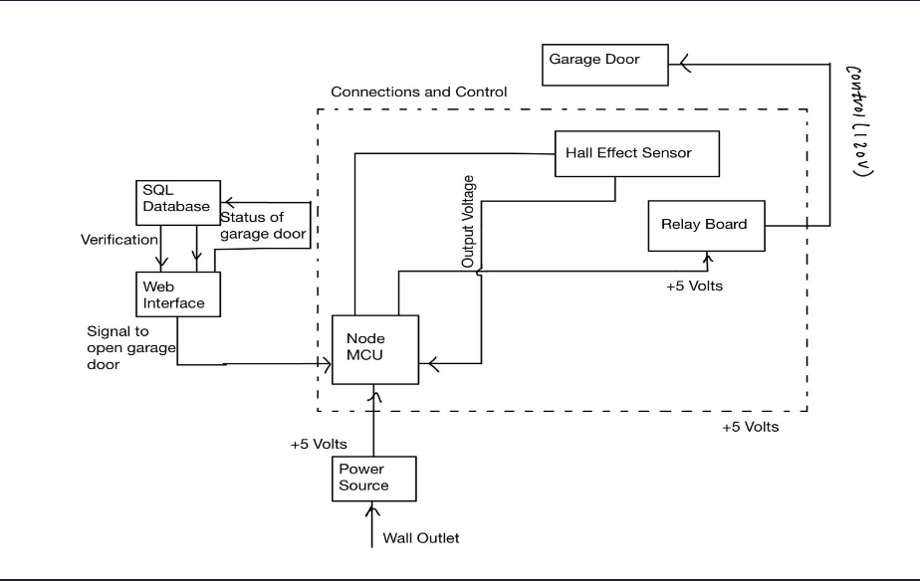
System Design
Block Diagram with design that uses a 5V power source to power NodeMCU
NodeMCU will use button pressed value to to send signal to relay board to open garage door
NodeMCU reads hall effect sensor value and sends it to web server to display garage status
Database used to verify the user logging in as well as updating the button pressed value
Relay Board is connected to the garage lifter and comes from the NodeMCU which uses a low voltage power source allowing us to lift the garage which requires a high voltage
Notes:
Anwar

Slide 9
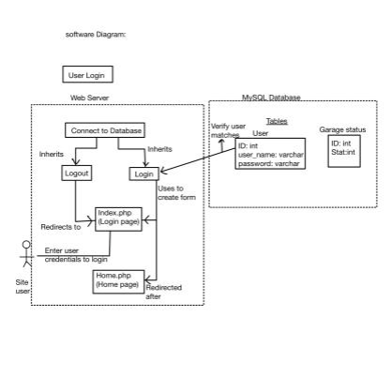
Detailed Design (Software User Login)
The first thing the web server does is connect to the database and both the login and logout inherits the file that does so
Site user enters their credentials through the login page, index.php, which has a form that uses login.php
Once user has entered credentials, the Login file will handle parsing the user credentials and runs SQL query to compare the user_name and password stored in the database
Login will then redirect the user to the homepage for the garage door
Logout button on home page will redirect user back to the login page
Notes:
Awnar

Slide 10
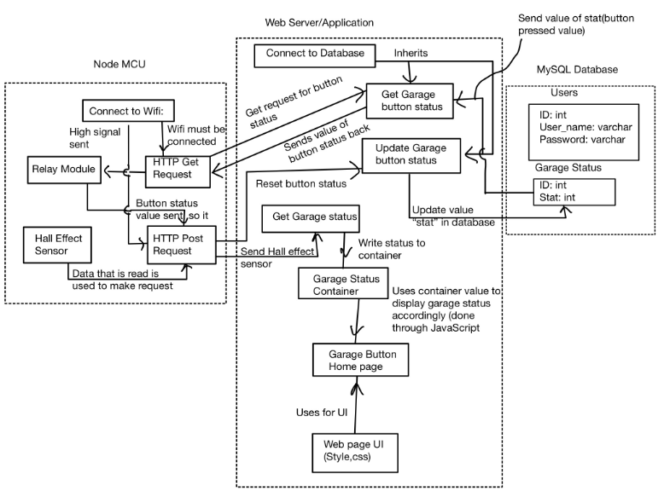
Detailed Design (Software Interaction with Garage Door)
NodeMCU connects to wifi sends http get and post requests to the web server
Web Server connects to database and button status set to 1 when button is pressed which NodeMCU retrieves via httpGet Request to trigger garage
Button status is reset after garage opens/closes via httpPost Request, database value updated
Web server retrieves hall effect sensor data via http Post Request and stores in container to determine what status of the garage is shown
Notes:
Anwar

Slide 11
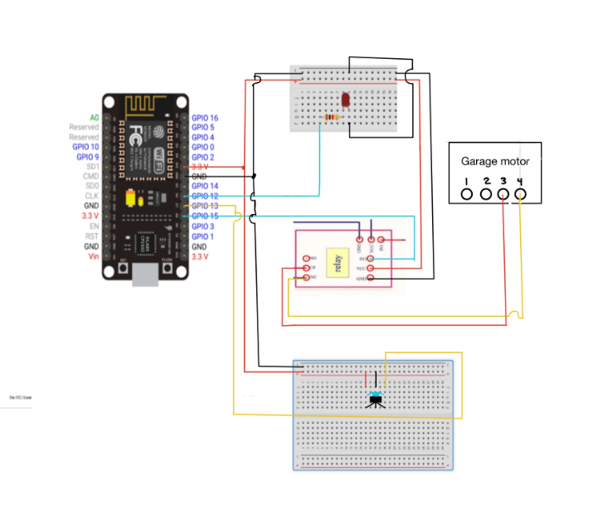
Detailed Design (Hardware)
NodeMCU uses the relay module to control the garage lifter via NC configuration
The relay module is connected to the garage lifter by removing wires connected to physical default garage button, and uses NC and COM Pins
Hall effect sensor is used for status of the garage and placed near magnet that is near the garage belt
Led is used in the circuit for testing purposes and turns on briefly when button is pressed
Notes:
Luis
This is our detailed design hardware schematic. We see that we have 5 components in total.
Led is connected to D6 on our Node mcu
Our relay module is connected to d8
Hall effect sensor is connected to d7

Slide 12

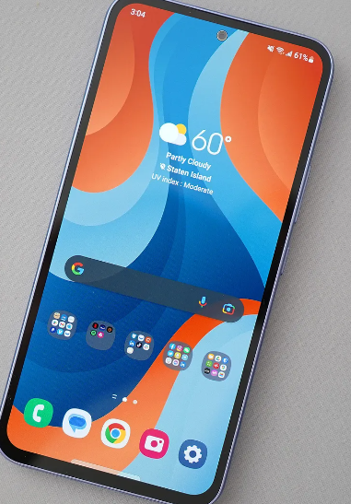
System Test Plan (Website Only)
Equipment List:
Electronic device connected to wifi or mobile network
Link to website after created
Procedure:
Use web address created with web hosting service and see if login page is loaded
Login to website with at least 3 different users saved in the database
Login to website with invalid user_name or password, need both inputted in textbox
Login to website with no user_name entered
Login to website with no password entered
Login with existing user saved in database
Notes:
Anwar

Slide 13

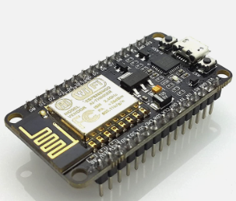
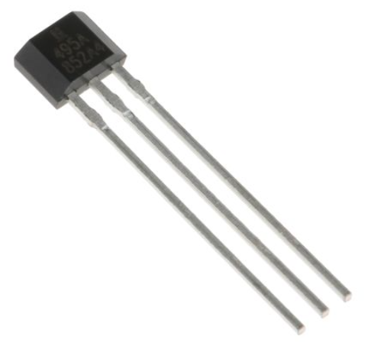
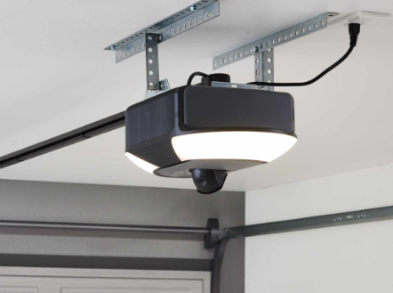
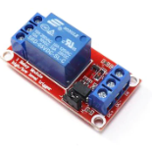
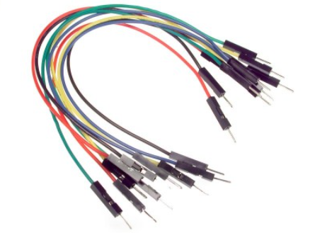
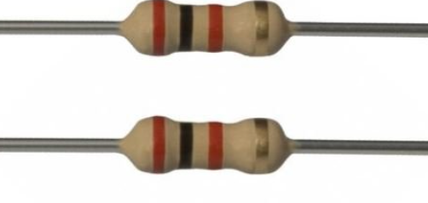
System Test Plan (Garage Door Interaction)
Equipment List:
NodeMCU connected to wifi network that will be used for garage opener
Garage lifter
Hall effect sensor
Wires
1 Magnet
Relay Module
2 Resistors (2k Ohms)
Electronic device connected to separate network
Link to website that will be used
Procedure:
Login with existing user saved in database
Once redirected to welcome page, press button to open to garage door
After garage door is open, press the button again to see if the garage closes
Check that garage status is correct after opening or closing garage via button press
Notes:
Luis

Slide 14

Economic Analysis
Comparing the original cost of the garage door opener, we were able to be pretty close to that except we forgot to account for the power adapter as well as a magnet
To produce this design at scale, other factors would have to be considered such as labor costs which are not here as we are not being paid to create this. In terms of the pure cost of materials when produced at scale, for roughly 100,000 units for example, the cost would be about 3.35 million dollars.
If we want to make a profit, a reasonable number would be about 40 dollars for the actual price which would net 4,000,000 dollars in revenue.
Economic Feasibility
When considering alternatives that we had access to, using the NodeMCU allowed us to be the most cost effective
When comparing our garage opener price to what is out in the market currently, it would be around the middle with some garage openers priced higher while others were lower
Notes:
Anwar

Slide 15
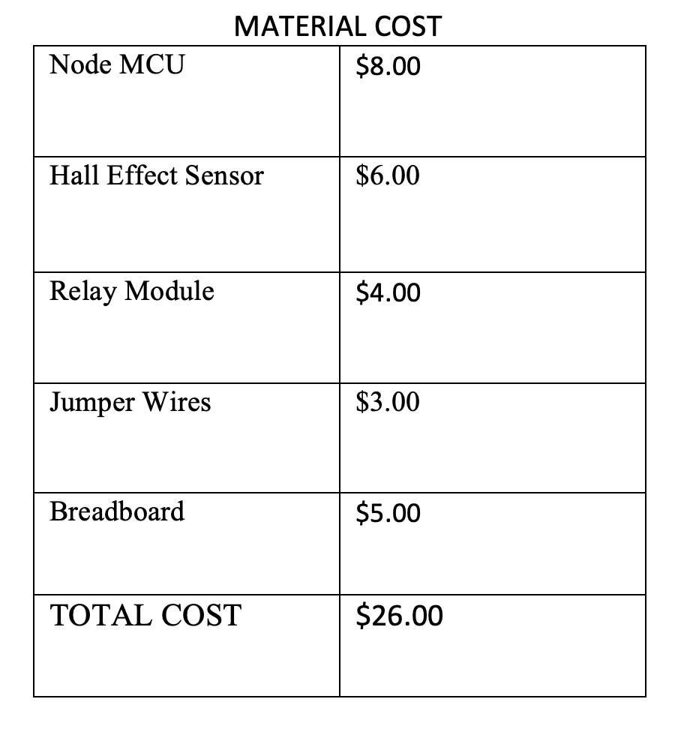
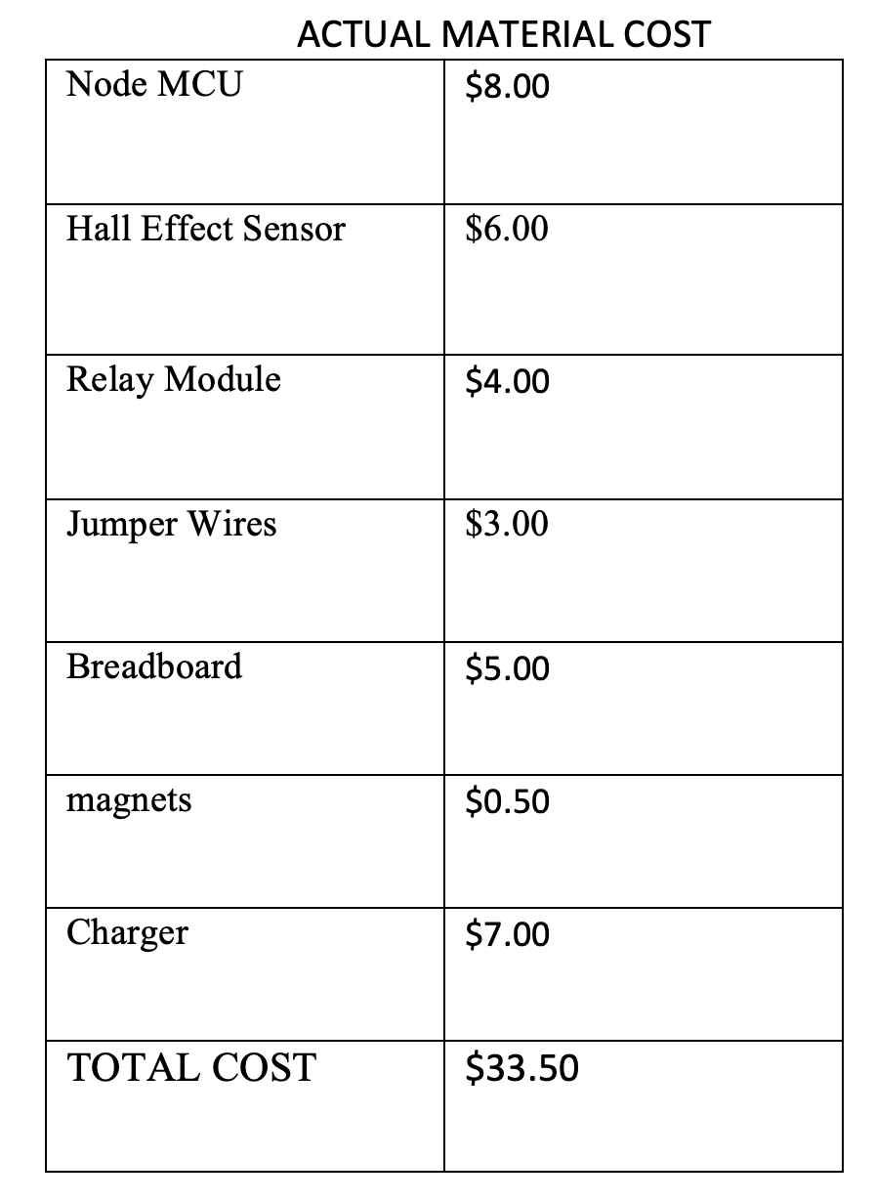
Economic Analysis Cont.
Material cost before: Actual material cost:
Notes:
Anwar

Slide 16
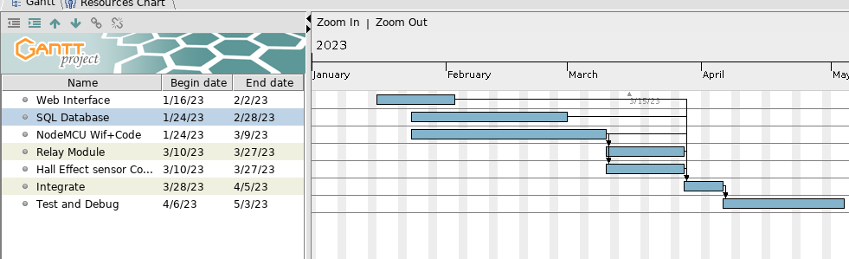
Original Project Plan
Notes:
Luis

Slide 17
Project Management
Web Interface( Expected: 2.5 weeks, Actual: 3 weeks):
Luis took the lead with everyone spending roughly the same amount of time
SQL Database ( Expected: 3.5 weeks, Actual: 6 weeks):
Anwar mainly worked on the database as he was taking the course with Luis and Ileana helping
NodeMCU & WIfi code(Expected: 3 Weeks, Actual: 3 weeks):
Luis mainly worked on with Anwar and Ileana helping
Relay Board(Expected: 2 weeks, Actual: 2 weeks)
All group members worked on the module connecting the relay board to the garage with the lead being Ileana
Hall Effect Sensor(Expected: 2 weeks, Actual: 2 weeks)
Anwar took the lead on dealing with this part of the project
Integration (Expected: 1 week, Actual: 1 week)
Ileana was the lead for this part as her garage door was being used
Test and Debug(Expected: 1 month, Actual: 1 month)
All group members spent an equal amount of time testing and debugging
Notes:
Luis
Here is our actual adjusted time spent on each section

Slide 18

Project Management Cont.
Our time could’ve been managed better as it took more time in terms of hours spent than initially planned
More time was spent due to lack of understanding and underestimating tasks
We were able to mainly stick to our timeline that we had planned due to constant communication
Notes:
Luis

Slide 19

Challenges (Will Change)
One challenge we faced was not being familiar with web development and a lot of the time was spent doing that
Another challenge we faced was time management even though we were close meeting date deadlines for the most part
The last challenge was working with the database initially since when we proposed with this project, no one had any experience with one

Slide 20

Future Work
Strengths
Cost Effective
Different web hosting services can be used since php was used
Database is used for security when users login
Weaknesses
Tested on only one garage door
Delay with status, and opening/closing garage door
Website potentially not secure
Could make UI a little cleaner
More features can be added such as attempted login time or notification when garage has been opened to be more useful
Notes:
Anwar

Slide 21
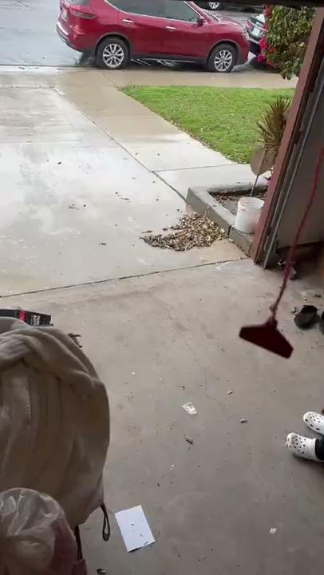
Integration

Slide 22

DEMO

Slide 23
Q&A

